Slide 1
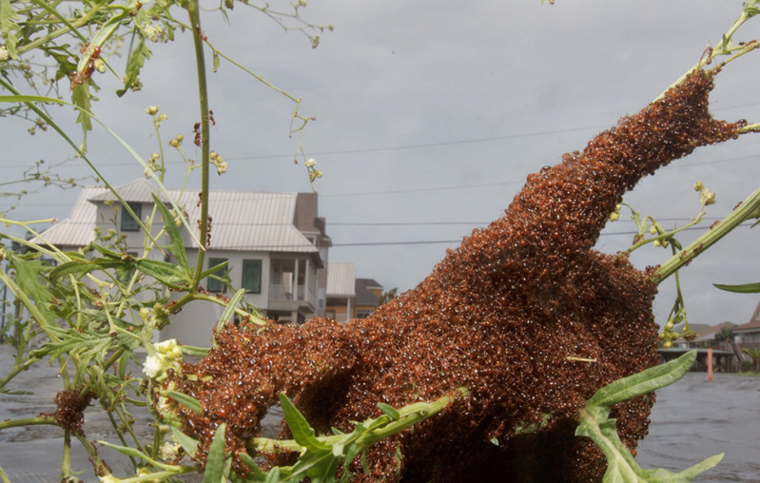
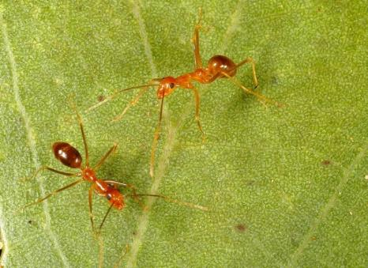
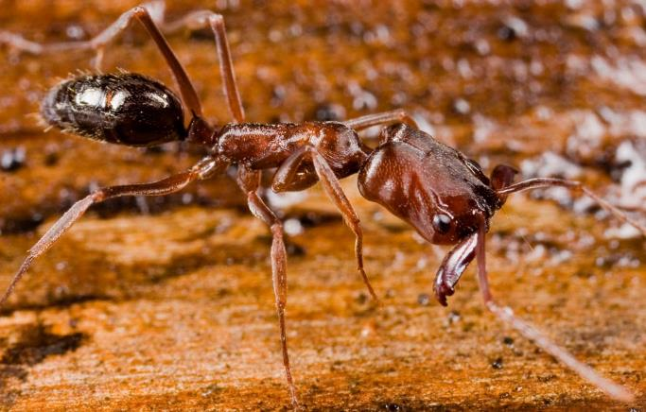
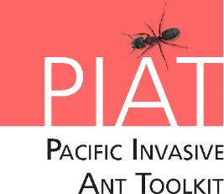
Hi Ants!
Notes:
Credits: Left to right: © Matthew Hinton (http://photos.nola.com/nolacom_photo_essays/2011/09/photographers_lens_tropical_st.html#photo-9971883) (sent an email Nov 02/2016 asking permission, awaiting response), © Eli Sarnat, Share Alike CC BY-SA Licence and © Phil Lester.

Slide 2
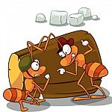
What are we going to learn today?
The top five invasive ant pests.
The problems they cause to our people, our agriculture and our natural environment.
Where these ants come from and how they arrive in our country.
Image courtesy of TAW4 at FreeDigitalPhotos.net
Notes:
Credits: Image from Image courtesy of TAW4 at FreeDigitalPhotos.net retrieved from http://www.freedigitalphotos.net/images/agree-terms.php?id=100300418

Slide 3
Ants? What are they?
Ants are living things. They need air, food and water.
Ants are insects.
They have 3 body parts and 6 legs.
They are in the same family as wasps and bees.
The queen ant can lay thousands of eggs a day.
Notes:
Credits: © Phil Lester
Ants = kinongo (Kiribati language)

Slide 4
What is an invasive ant?
Image courtesy of TAW4 at FreeDigitalPhotos.net
Notes:
Credits: Image from Image courtesy of TAW4 at FreeDigitalPhotos.net

Slide 5
What is an invasive ant?
An ant that is introduced outside its home range and that damages the natural environment of its new home.
The picture shows red imported fire ants travelling over floodwaters on an uprooted tree
Notes:
An ant outside its home range is considered invasive when it damages the human or natural environment. Some ants only become invasive when they reach high numbers. The photo shows fire ants covering a myrtle shrub.
Credits: © Matthew Hinton (http://photos.nola.com/nolacom_photo_essays/2011/09/photographers_lens_tropical_st.html#photo-9971883) (sent an email Nov 02/2016 asking permission, awaiting response)

Slide 6
Are all ants invasive?
Image courtesy of TAW4 at FreeDigitalPhotos.net
Notes:
Credits: Image from Image courtesy of TAW4 at FreeDigitalPhotos.net

Slide 7
Are all ants invasive?
No!
Only some introduced ants cause problems.
Some ants are only bad in great numbers.
Most ants do good things for the environment. They cycle nutrients in soil and eat the larvae of household pests like flies and cockroaches.
The ant in the picture is called a trap jaw ant. It has been introduced into the Pacific but does not cause problems (although it can bite!)
Notes:
Ants perform a number of tasks that are good for the environment. Perhaps most importantly they assist in the breakdown of organic materials and nutrient cycling. Even ants that are introduced outside of their natural range can benefit the environment.
The ant in the picture is Odontomachus similimus. It is one of the biggest introduced ants in the Pacific and while it can give a nasty bite and has a painful sting, it is not aggressive. It is a slow moving solitary hunter that rarely causes people ant bother.
Some ants only become a problem when they reach high numbers. Others cause problems because they sting or spray acid.
It is important that students understand that not all ants are a problem. Generally, ants are beneficial to the environment acting as decomposers and soil enrichers. Some ants (such as yellow crazy ants) are only a problem in large numbers.
Credits: © Eli Sarnat, Share Alike CC BY-SA Licence

Slide 8
Are all ants bad?
Image courtesy of TAW4 at FreeDigitalPhotos.net
Notes:
Credits: Image from Image courtesy of TAW4 at FreeDigitalPhotos.net

Slide 9
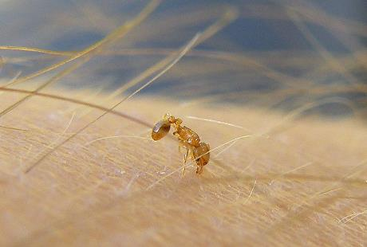
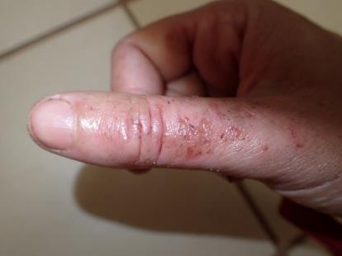
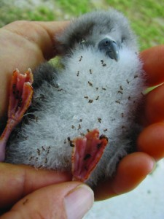
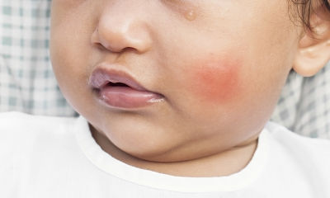
Why are some ants bad?
Clockwise from left: A little fire ant biting; skin rash caused by yellow crazy ants; Sea bird chick covered by African big-headed ants; a child stung on the cheek by a fire ant; ants ‘farm’ scale insects, which damage crops.
Notes:
When invasive ants reach high abundance, they can be a major nuisance in three ways: 1. they farm scale insects, aphids and other honeydew producing bugs, which damage crop plants, reduce yields and spread crop diseases. 2. They can kill or injure local wildlife including birds, crabs, lizards, insects and can make it difficult for stock animals like pigs and chickens to feed. 3. Many invasive ants sting or bite when disturbed. Stings can form blisters and become infected. Sometimes the ants can grow to such high numbers that people cannot eat, work or sleep because there are always ants crawling all over them.
Additional Information:
Damage to agriculture and crops. Invasive ants don’t directly damage crops, but they “farm” sap sucking insects such as aphids, scale insects and mealy bugs that do. These sap sucking insects directly damage the plants and spread plant diseases. The ants protect the sap sucking pests from predators, which allows the pests to increase their numbers. In return the ants collect the sugary honeydew that the sap suckers excrete. The ants also make it difficult for stock animals such as pigs and chickens to eat or sleep and the ants may also kill and eat newly hatched chicks.
Damage to the environment. Ants are hungry predators. When they are in large numbers invasive ants kill other insects, birds, crabs, lizards and other animals. Some of these animals perform important actions for the whole ecosystem. For example, on Christmas Island crabs remove seedlings of understorey vegetation. When yellow crazy ants killed all the crabs, the understorey vegetation went wild. The large numbers of understorey plants shaded out all the canopy seedlings. This meant that there would be no new canopy trees to replace old ones that fell and that the entire ecosystem would change. As some birds and other animals depend on these canopy trees for food and shelter their numbers decline. This in turn affects the birds and other animals that preyed on them. So, ants killing the crabs had an effect on the entire ecosystem. Some Pacific ecosystems are not well understood, so it is uncertain what large scale effects invasive ants may have on them.
Invasive ants can cause humans great discomfort. Some species of ants bite, while others sting or spray acid when they are disturbed. In large numbers the ants make it difficult for people to eat, gather food, work or sleep as they crawl all over them day and night. Ask the students to share any stories they may have about ants in their homes, on their family’s crops or that they might have seen in the bush.
Credits clockwise from left © Plegadis, Wikipedia, © Meghan Cooling, © Sheldon Plentovich, © Shutterstock / Panya Kuanun, MISC website, © Phil Lester

Slide 10
What we have learnt today
Ants are insects. They have 3 body parts and 6 legs.
They are in the same family as wasps and bees and the queen can lay thousands of eggs everyday.
An ant is invasive when it has left its home range and damages the natural environment of its new home.
Not all ants are invasive. Most do good things for the environment like helping decomposition.
Some ants are bad because they can cause harm to our farms, human and our environment.
Image courtesy of TAW4 at FreeDigitalPhotos.net
Notes:
Credits: Image from Image courtesy of TAW4 at FreeDigitalPhotos.net

Slide 11
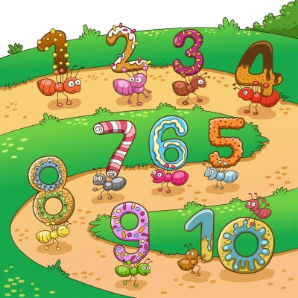
For our next lesson
Can you think about any stories you may have about ants in your homes, on your family’s crops or you might have seen in the bush? It can be your personal story or stories from your family members.
Come ready to share them at the next lesson.
Image courtesy of AKARAKINGDOMS at FreeDigitalPhotos.net
Notes:
Credits: Image from Image courtesy of AKARAKINGDOMS at FreeDigitalPhotos.net retrieved from http://www.freedigitalphotos.net/images/agree-terms.php?id=100300418

Slide 12
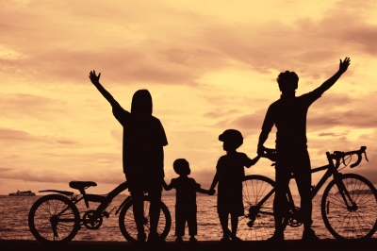
See you next time!
Image courtesy of arztsamui at FreeDigitalPhotos.net
Notes:
Credits: Image from Image courtesy of arztsamui at FreeDigitalPhotos.net

